Slide 1


Lost in the Sauce of Bat Flight Simulation
Alexander Mervar

Slide 2
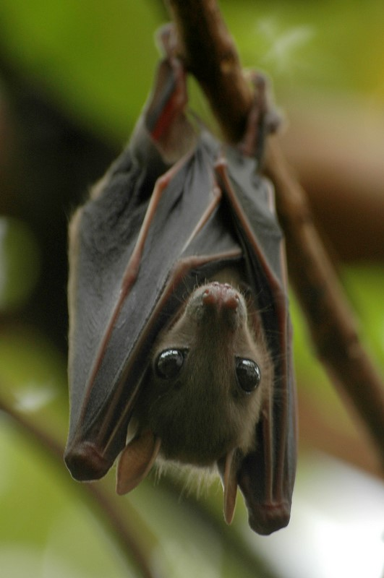
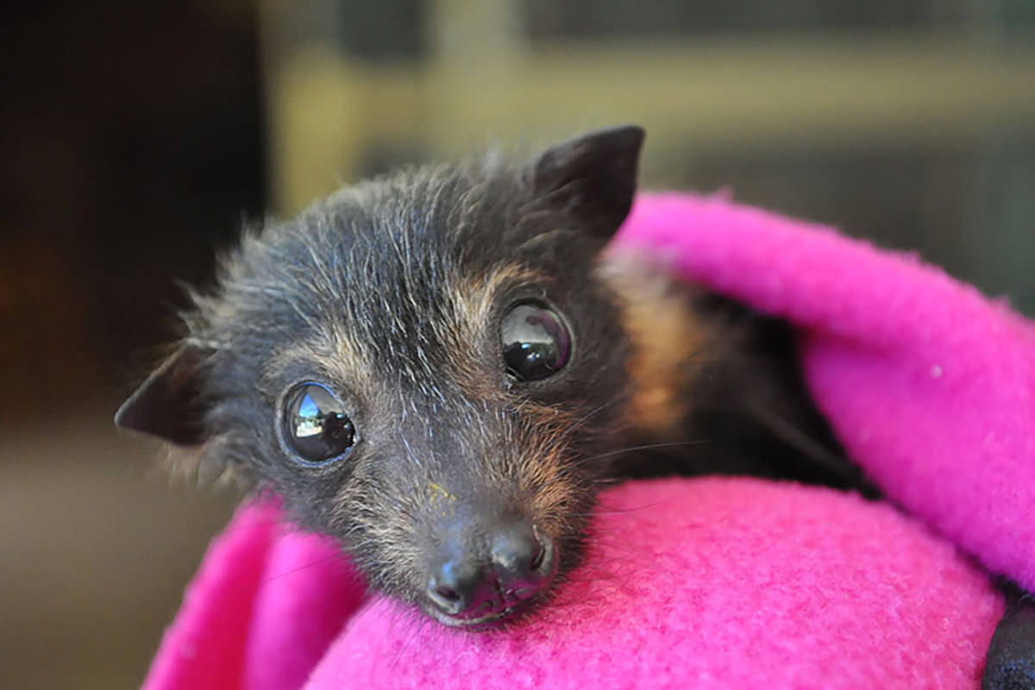
Alexander, why are you doing this? What’s the point?
This Photo by Unknown Author is licensed under CC BY-NC-ND
This Photo by Unknown Author is licensed under CC BY-NC-ND

Slide 3
Bats… How do they do it?
They use their ears during echolocation
01
Wings move them from Point to Point
02
Able to manipulate their echolocation to suit their needs
03

Slide 4
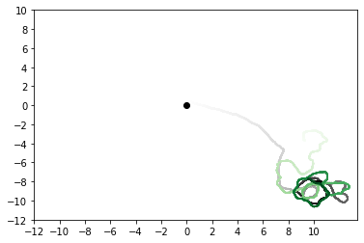
Version 0.1
What went Right/Wrong
Track the Bug Agent – Success
Echolocation Works
Hard to Visualize Where the Bat Agent
Needs more than one Bug Agent

Slide 5
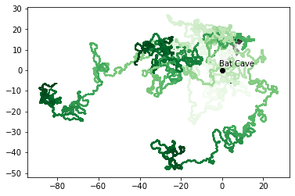
Version 0.2
What went Right/Wrong
Track the Bug Agent – Success
Echolocation Works
Bat Tracks Multiple Bug Agents
Bugs are “Eaten”
Cool Batman Reference
Hard to Visualize Where the Bat Agent
Graph is Too Busy

Slide 6
How Does Eating Work
Bat Detects the Distance Between Itself and Target Agent (Bug)
Bug Stops Moving when Bug Agent Interacts with it Through Calling a Function
Bat Changes its Target

